Slide 1
Image captioning with attention
Eswar Balaji Jalaparthi

Slide 2
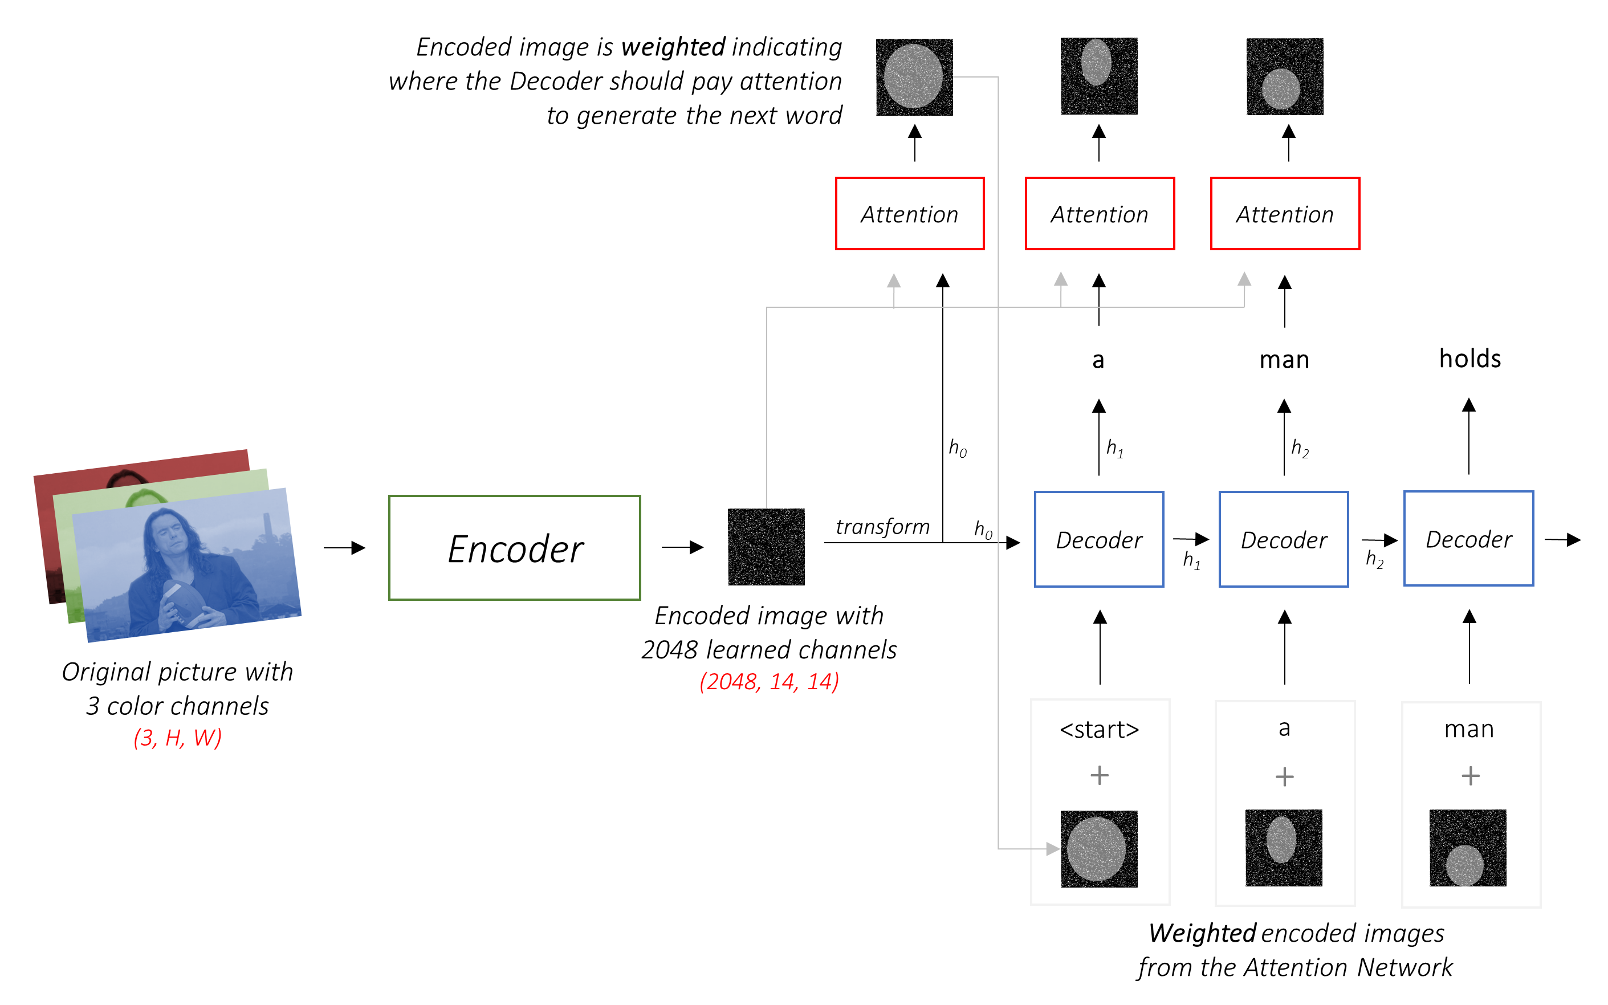
Image captioning model

Slide 3
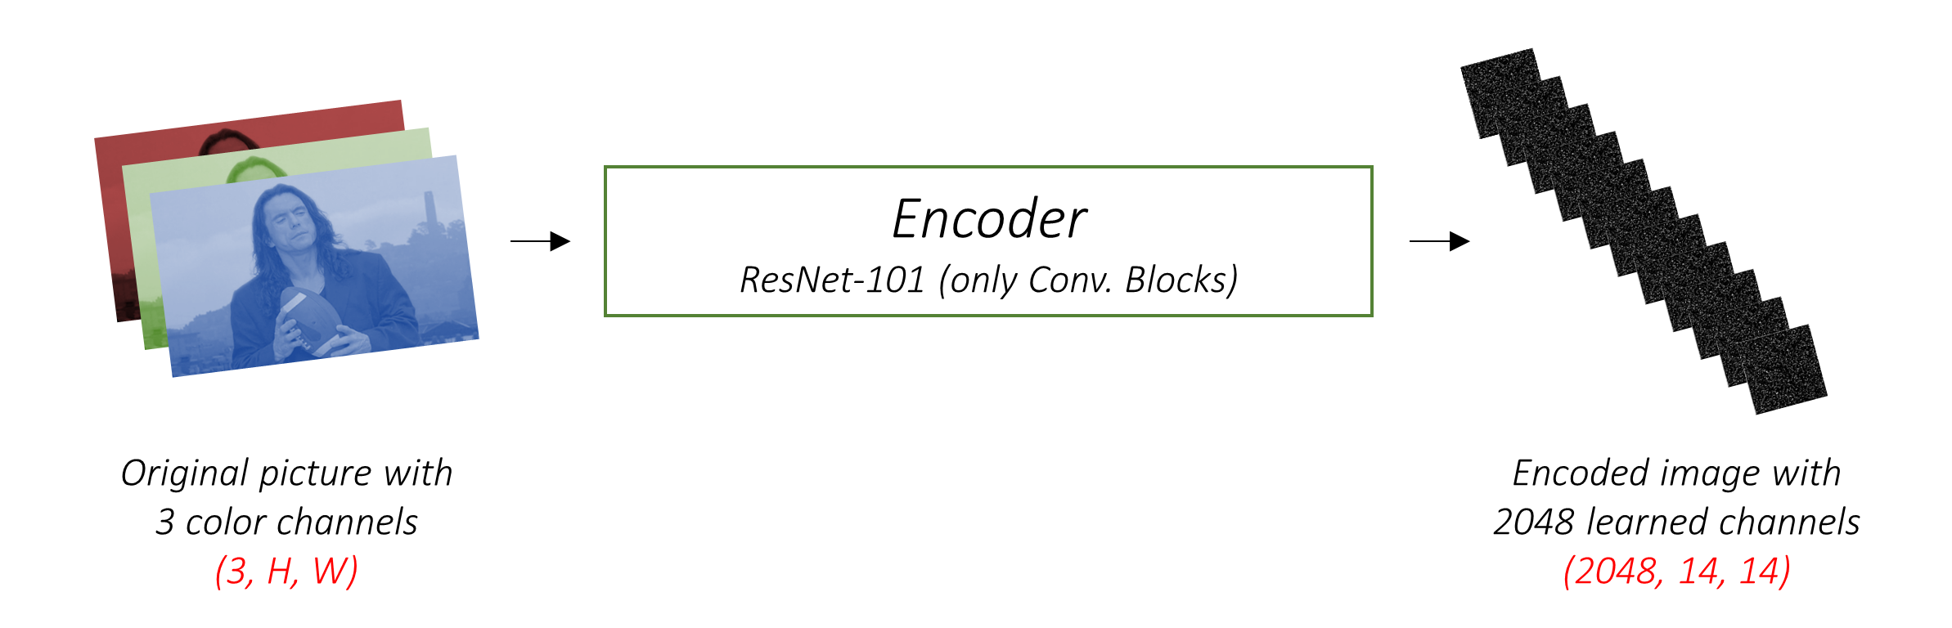
Encoder
The Encoder encodes the input image with 3 color channels into a smaller image with "learned" channels.
These models progressively create smaller and smaller representations of the original image, and each subsequent representation is more "learned", with a greater number of channels. The final encoding produced by our ResNet-101 encoder has a size of 14x14 with 2048 channels, i.e., a 2048, 14, 14 size tensor.

Slide 4
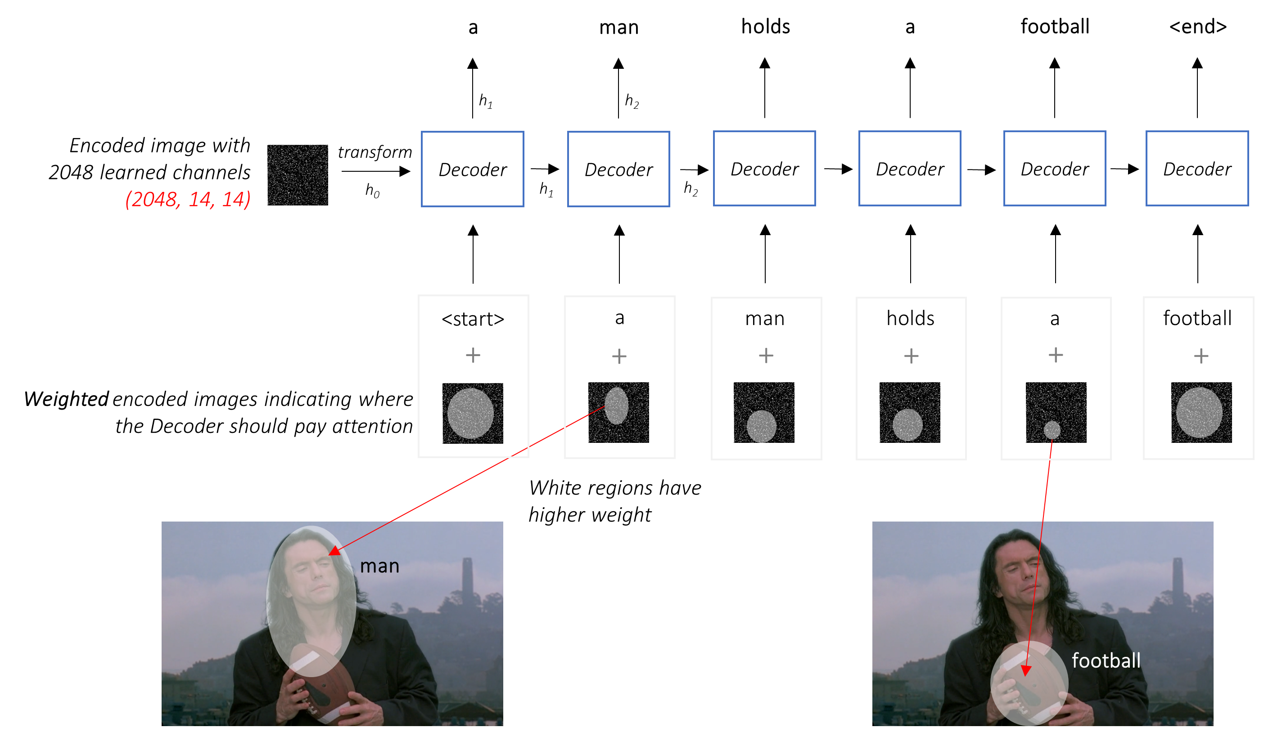
Decoder

Slide 5
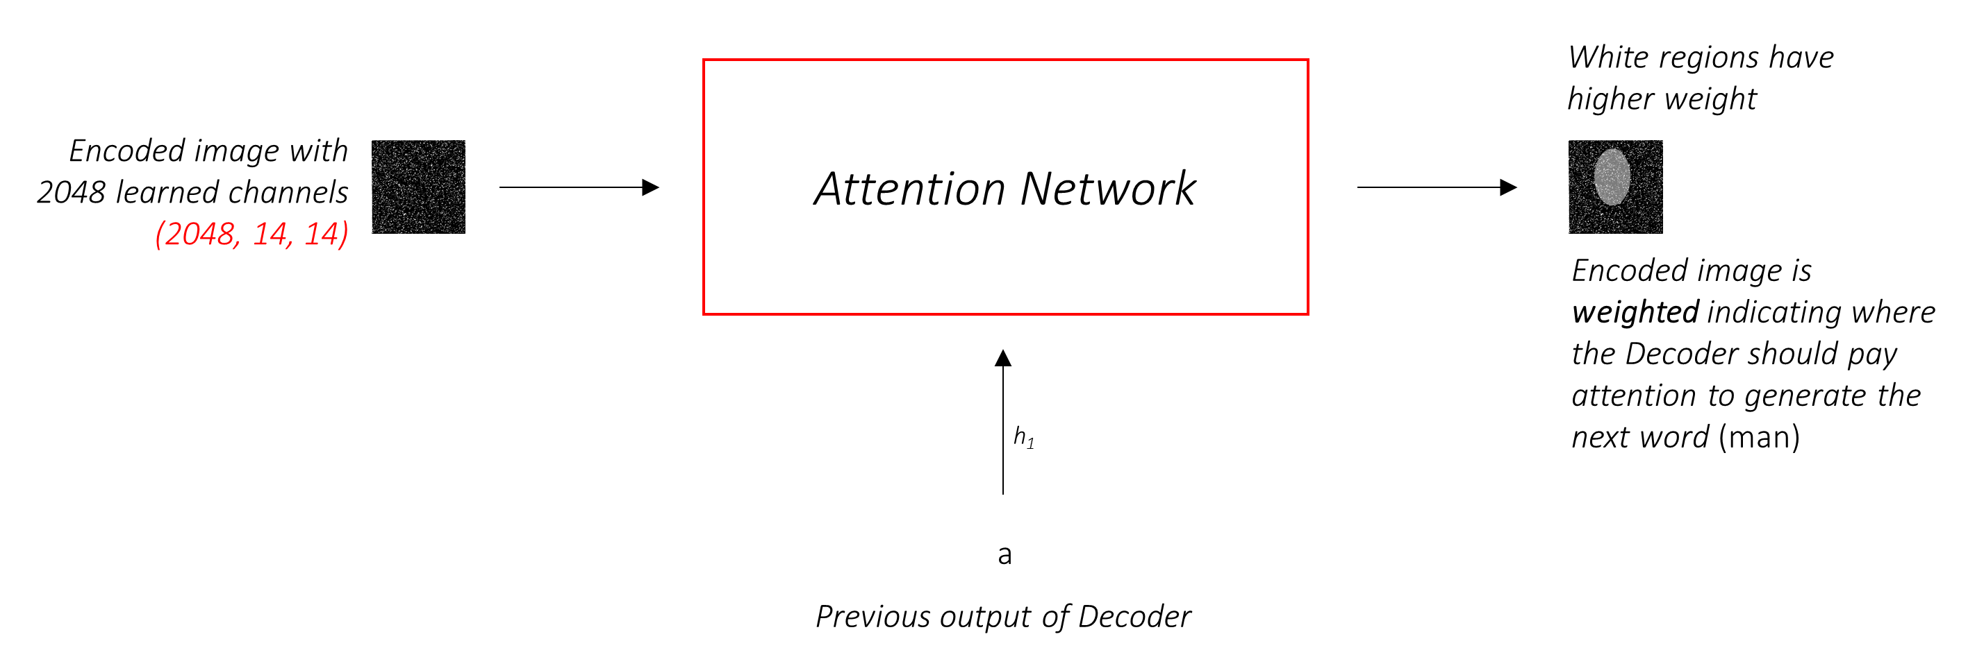
Attention
We will use soft Attention, where the weights of the pixels add up to 1. If there are P pixels in our encoded image, then at each timestep t –
You could interpret this entire process as computing the probability that a pixel is the place to look to generate the next word.

Slide 6
Parameters
emb_dim = 256 # dimension of word embeddings
attention_dim = 256 # dimension of attention linear layers
decoder_dim = 256 # dimension of decoder RNN
dropout = 0.5
device = torch.device("cuda" if torch.cuda.is_available() else "cpu") # sets device for model and PyTorch tensors
cudnn.benchmark = True # set to true only if inputs to model are fixed size; otherwise lot of computational overhead
# Training parameters
start_epoch = 0
epochs = 20 # number of epochs to train for (if early stopping is not triggered)
epochs_since_improvement = 0 # keeps track of number of epochs since there's been an improvement in validation BLEU
batch_size = 32
workers = 1 # for data-loading; right now, only 1 works with h5py
encoder_lr = 1e-4 # learning rate for encoder if fine-tuning
decoder_lr = 4e-4 # learning rate for decoder
grad_clip = 5. # clip gradients at an absolute value of
alpha_c = 1. # regularization parameter for 'doubly stochastic attention', as in the paper
best_bleu4 = 0. # BLEU-4 score right now
print_freq = 100 # print training/validation stats every __ batches
fine_tune_encoder = False # fine-tune encoder?
checkpoint = None # path to checkpoint, None if none
vocab_size = len(vocab)

Slide 7
References
https://github.com/sgrvinod/a-PyTorch-Tutorial-to-Image-Captioning
https://arxiv.org/abs/1502.03044

